Slide 1
HTML (Hyper Text Markup Language)
Tip: Use graphics to set the tone of the speech.
Prepared By: Quratulain
Notes:
Be specific and direct in the title. Use the subtitle to give the specific context of the speech.
-The goal should be to capture the audience’s attention which can be done with a quote, a startling statistic, or fact. It is not necessary to include this attention getter on the slide.

Slide 2
Grouping Content
The <div> element:
It represents a generic block of content and is designed to be used with classes and ids to give structure to documents.
For example, if you want to set the header apart in some way, you can mark it up like the following example. Using a <div> with a class of header you can encapsulate the site title and tagline into a single structure: <div class="header"> <h1>EXAMPLE CAFE</h1> <p>Welcome to example cafe. We will be developing this site throughout the book.</p> </div>
Web Engineering\Division.html
Notes:
Although this is actually quite useful for styling and scripting, there’s no semantic meaning behind the <div>, no matter how well chosen the classes or ids are. As you see throughout this section, the new sectioning elements in HTML5 enhance the utility of the <div> with (mostly) straightforward semantic meaning.

Slide 3
<header> tag
Header represents a container for introductory content or a set of navigational links. It can contain:
logo or icon
authorship information
You can have several <header> elements in one document.
But a <header> tag cannot be placed within a <footer> or another <header> element.
The <header> element:
<header>
<h1>EXAMPLE CAFE</h1>
<p>Welcome to example cafe. We will be developing this site throughout
the book.</p>
</header>
Notes:
As part of the development of the new specification, the editor of the HTML standard, Ian Hickson, did a survey of the web and identified common markup patterns. Some of these he captured as new HTML elements. This is one such element. As you saw in the previous example, the concept of a “header” for common introductory or navigation content is a useful one and was repeated over and over on the web. Marking up the previous example with a <header> simplifies the markup and imparts more semantic meaning to the page. <header>

Slide 4
(cont..)
The <hgroup> element:
The <hgroup> element is designed to group together multiple levels of headings that have some logical connection, for example, subheadings, alternative titles, or taglines.
Adding an <hgroup> element, and silly tagline, to the previous example illustrates how to use the <hgroup> element:
<header>
<hgroup>
<h1>EXAMPLE CAFE</h1>
<h2>Serving Home Style Example Markup since 2012</h2>
</hgroup>
</header>
Notes:
The <hgroup> element is designed to group together multiple levels of headings that have some logical connection, for example, subheadings, alternative titles, or taglines. Adding an <hgroup> element, and a silly tagline, to the previous example illustrates how to use the <hgroup> element:

Slide 5
The <nav> element:
The <nav> element represents a navigation section of the page, containing a list of links to other pages or site sections within the site or application.
<nav>
<p><a href="recipes.html">Recipes</p>
<p><a href="menu.html">Menu</a></p>
<p><a href="opening_times.html">Opening Times</a></p>
<p><a href-"contact.html">contact</a></p>
</nav>
Notes:
The <nav> element represents a navigation section of the page, containing a list of links to other pages or site sections within the site or application. Because the Example Café site is going to have more than one page, look at one way to mark up a simple menu linking to other pages on the site. In this example you can see a series of <p> tags, containing links to the site’s other pages. Later you learn about working with lists and learn a more common pattern for marking up navigational elements. For now, just focus on the use of the <nav> element.

Slide 6
The <section> element
The <section> element is used to represent a section of a document or application. A <section> differs from a <div>, the most generic content grouping element, by the idea that content contained in a <section> is designed to be part of the document’s outline.
<section> <h1>Introduction</h1> </section> <section> <h1>Recipes</h1> </section>
<section> <h1>Menu</h1> </section> <section> <h1>Opening Times</h1> </section> <section> <h1>Contact</h1> </section>
Notes:
The <section> element is used to represent a section of a document or application. A <section> differs from a <div>, the most generic content grouping element, by the idea that content contained in a <section> is designed to be part of the document’s outline. Although the Example Café site is going to have separate pages, it can conceivably be one page broken into several sections. A simplified example, just using the headings for each section and no content, would look something like this:

Slide 7
The <hr> element The <hr> element creates a horizontal rule across the page. It is an empty element, rather like the <br> element. <hr> This is frequently used to separate distinct sections of a page where a new heading is not appropriate.

Slide 8
<figure> - Specifies self-contained content, like illustrations, diagrams, photos, code listings, etc.
Positioning/ placement of an image in a document is independent - If removed does not effect the flow of document.
figcaption can be used to caption an image
Web Engineering\figure.html

Slide 9
The <blockquote> element
When you want to quote a passage from another source, you should use the <blockquote> element.
<p>The following description of the blockquote element is taken from the WHATWG site:</p> <blockquote> The blockquote element represents a section that is quoted from another source. Content inside a blockquote must be quoted from another source, whose address, if it has one, may be cited in the cite attribute.</blockquote>
Notes:
Text inside a <blockquote> element is usually indented from the left and right edges of the surrounding text, and some browsers use an italicized font

Slide 10
using the cite attribute with the <blockquote> element
You can use the cite attribute on the <blockquote> element to indicate the source of the quote.
The value of this attribute should be a URL pointing to an online document; if possible, the exactplace in that document.
Browsers do not currently do anything with this attribute, but it means the source of the quote is there should you need it in the future
<blockquote cite=
"http://developers.whatwg.org/grouping-content.html#the-blockquote-element">
The blockquote element represents a section that is quoted from another source.
Content inside a blockquote must be quoted from another source, whose address,
if it has one, may be cited in the cite attribute.</blockquote>

Slide 11
The <footer> element
A <footer> element typically contains:
authorship information
copyright information
contact information
sitemap
back to top links
related documents
Web Engineering\header footer.html
Web Engineering\header and footer.html
A common usage of the footer is for legal copy.
<footer> <p>All content copyright Example Café 2021</p> </footer>

Slide 12
Working with Lists
You can create three types of lists in HTML:
➤➤ Unordered: Like lists of bullet points
➤➤ Ordered: Use a sequence of numbers or letters instead of bullet points
➤➤ Definition: Enable you to specify a term and its definition

Slide 13
using the <ul> element to Create unordered Lists
If you want to make a list of bullet points, write the list within the <ul> element (which stands for unordered list).
Each bullet point or line you want to write should then be contained between opening <li> tags and closing </li> tags. (The li stands for list item.)
<ul>
<li>Bullet point number one</li>
<li>Bullet point number two</li>
<li>Bullet point number three</li>
</ul>

Slide 14
Example:
<nav>
<ul>
<li><a href="recipes.html">Recipes</li>
<li><a href="menu.html">Menu</a></li>
<li><a href="opening_times.html">Opening Times</a></li>
<li><a href-"contact.html">contact</a></li>
</ul>
</nav>

Slide 15
ordered Lists
Sometimes, you want your lists to be ordered. In an ordered list, rather than prefixing each point with a bullet point, you can use either numbers (1, 2, 3), letters (A, B, C), or Roman numerals (i, ii, iii) to prefix the list item.
An ordered list is contained inside the <ol> element. Each item in the list should then be nested inside the <ol> element and contained between opening <li> and closing </li> tags

Slide 16
Example
<ol>
<li>Point number one</li>
<li>Point number two</li>
<li>Point number three</li>
</ol>
Web Engineering\lists.html
Navigation Bars

Slide 17
Using the start Attribute to Change the Starting number in Ordered Lists
<ol start="4">
<li>Point number one</li>
<li>Point number two</li>
<li>Point number three</li>
</ol>
Notes:
If you want to specify the number that a numbered list should start at, you can use the start attribute on the <ol> element. The value of this attribute should be the numeric representation of that point in the list

Slide 18
Count Down in Your Ordered Lists with the reversed Attribute
The boolean reversed attribute allows you to reverse the order of ordered lists, counting down from the highest number (supported only in Chrome)
<ol reversed>
<li>Point number one</li>
<li>Point number two</li>
<li>Point number three</li>
</ol>

Slide 19
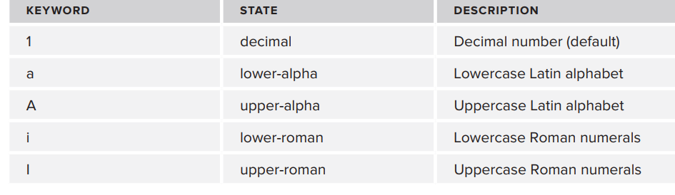
Specify a Marker with the type Attribute
The type attribute allows you to specify the class of markers to use with ordered lists.

Slide 20
Example:
<ol type="a">
<li>Point number one</li>
<li>Point number two</li>
<li>Point number three</li>
</ol>

Slide 21
definition Lists
The HTML5 spec states <dl> is for description lists, which have a slightly wider remit than term and definition.
“The <dl> element represents a description list, which consists of zero or more term-description (name/value) groupings; each grouping associates one or more terms/names (the contents of <dt> elements) with one or more descriptions/values (the contents of <dd> elements).”

Slide 22
The definition list is a special kind of list for providing terms followed by a short text definition or description for them.
Definition lists are contained inside the <dl> element.
The <dl> element then contains alternating <dt> and <dd> elements.
The content of the <dt> element is the term you define.
The <dd> element contains the definition of the previous <dt> element.

Slide 23
Example
<dl>
<dt>Unordered List</dt>
<dd>A list of bullet points.</dd>
<dt>Ordered List</dt>
<dd>An ordered list of points, such as a numbered set of steps.</dd>
<dt>Definition List</dt>
<dd>A list of terms and definitions.</dd>
</dl>

Slide 24
nesting Lists
You can nest lists inside other lists. For example, you might want a numbered list with separate points corresponding to one of the list items.
Number each nested list separately, unless you specify otherwise using the start attribute. And you should place each new list inside a <li> element

Slide 25
<ol type="I">
<li>Item one</li>
<li>Item two</li>
<li>Item three</li>
<li>Item four
<ol type="i">
<li>Item 4.1</li>
<li>Item 4.2</li><li>Item 4.3</li> </ol> </li> <li>Item Five</li> </ol>

Slide 26
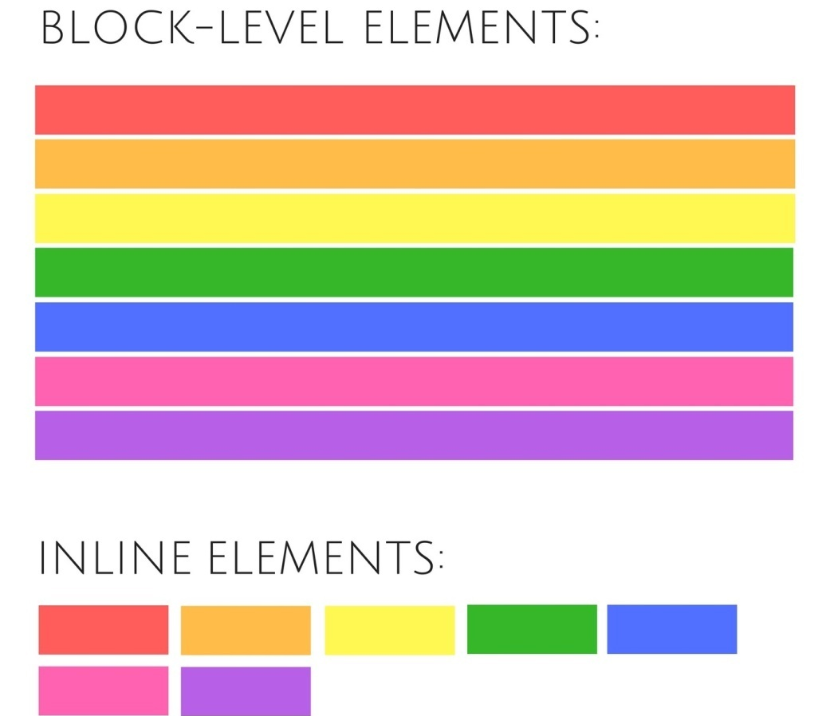
Some Other Tags
<q> - Quotes
<span> - Set the boundaries of the elements.
<sub> - Sub script
<sup> - Super script
Web Engineering\New Plain Text.html
Block level Vs. Inline elements

Slide 27
Any Questions???

